Slide 1
Student Loan Proposal
April 24, 2021
Presented by Nguyen Tran
Group 5

Slide 2
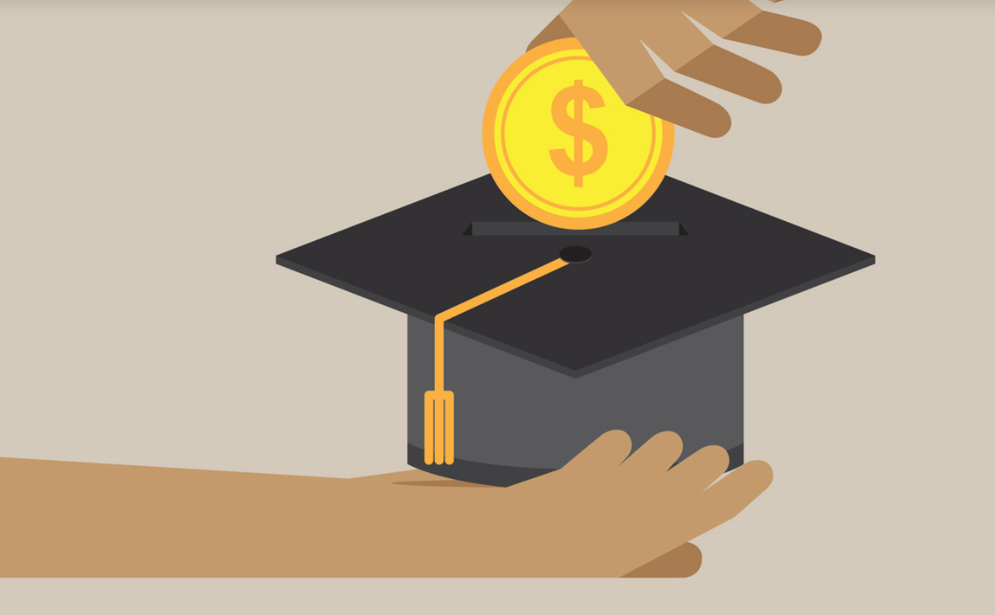
Introduction: Student Loan Proposal
Loans helps people afford college. It opens the door to attend college even for students who might not have the cash on hand to afford upfront.
However, loans are also easy path into extreme debt when students poorly managed.
It's important for students to fully understand and manage loans to ensure that they make responsible, and effective decisions about funding their education.
What’s about the situation in Oklahoma? This presentation will give an overview of student loans in Oklahoma, and propose a plan to have a manageable debt after graduation.

Slide 3
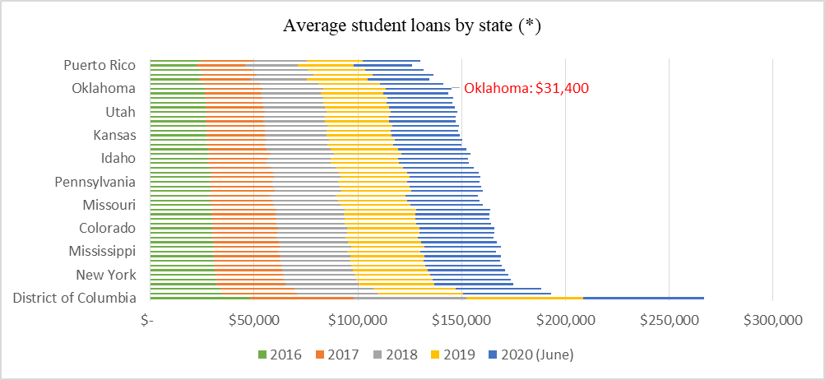
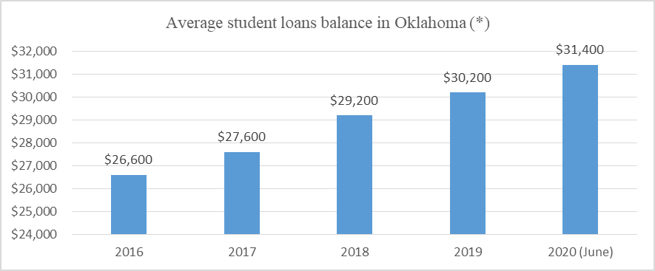
Student Loans Overview – Recent Trends
According to the statistics of newyorkfedorg, average student debt balance in the United States has grown more than 302 billion USD in the last five years to a record more than 1,800 billion USD as of June 2020.
Statistics showed that the average student loan debt in Oklahoma has increased 18%, from an average balance of 26,600 USD in 2016 to 31,400 USD in June 2020.

Slide 4
Student Loans Overview – Cause of the increase in student loan
The increase in student loan debt in Oklahoma can be attributed to a combination of several factors, such as college tuition and college costs.
Take Regional Universities in Oklahoma as an example, the tuition fee for full-time undergraduate and graduate resident students rose by 22.7 and 22.4 percent respectively from 2006 to 2020.
College costs also attributed to the increase in student loans, though this was not as obvious as it might seem.
Average Cost of Attendance for Resident Students in Regional Universities in Oklahoma
 | Full-Time Ungraduate |  | Full-Time Graduate
 | FY2016 | FY2020 | FY2016 | FY2020
Tuition | 4,577.05 | 5,616 | 4,587.09 | 5,619
Mandatory Fees | 1,341.36 | 1581 | 996.91 | 1,206
Average Academic Service Fees | 427.62 | 565 | 334.79 | 656
Books and Supplies | 1,240.45 | 1123 | 1,119.16 | 1,033
Total Costs for Commuter Students | 7,586 | 8886 | 7,037.96 | 8,514
Room and Board-Note 2 | 5,603.90 | 5,862 | 5,468.57 | 5,565
Total Costs for Students Living | 13,190 | 14,748 | 12,507 | 14,079

Slide 5
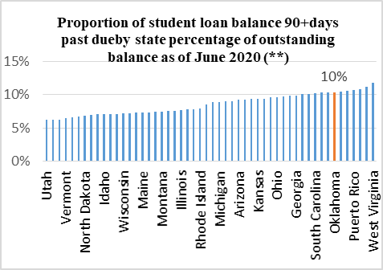
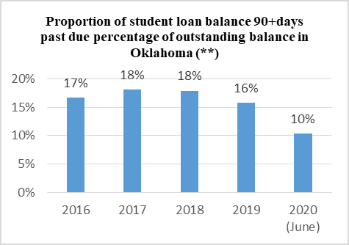
Student Loans Overview – Status of repayment
According to the statistics of newyorkfedorg, the proportion of student loan balances 90 days or more past due, including defaults by each state, were from 6% to 12% as of June 2020. In which, the highest percentages belonged to West Virginia (12%), while the percentage of Oklahoma was in middle (10%).
Failure to repay student loans can have serious financial consequences for students.

Slide 6
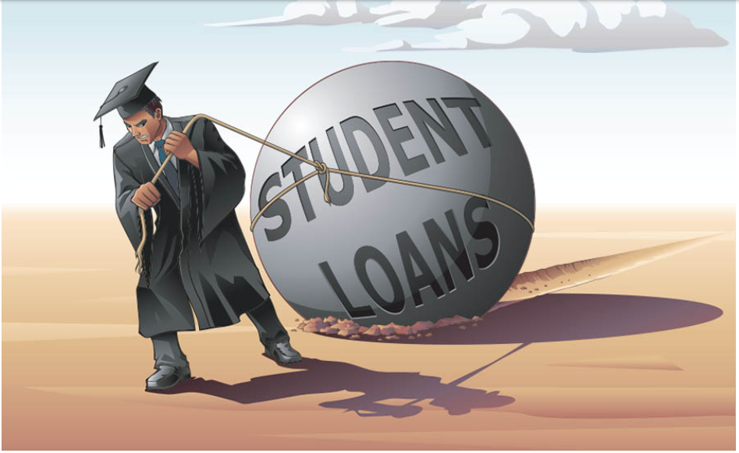
The Consequences of defaulting on loans
Not every student who takes out student loans can pay loans as scheduled. As we know, student loan default has serious financial consequences.
A lower credit cores. It will put students in a higher risk category.
Being disqualified for a job. A lower credit cores also affects students’ career.
Face a serious financial hardship.
Source: https://www.justbuildwealth.com

Slide 7
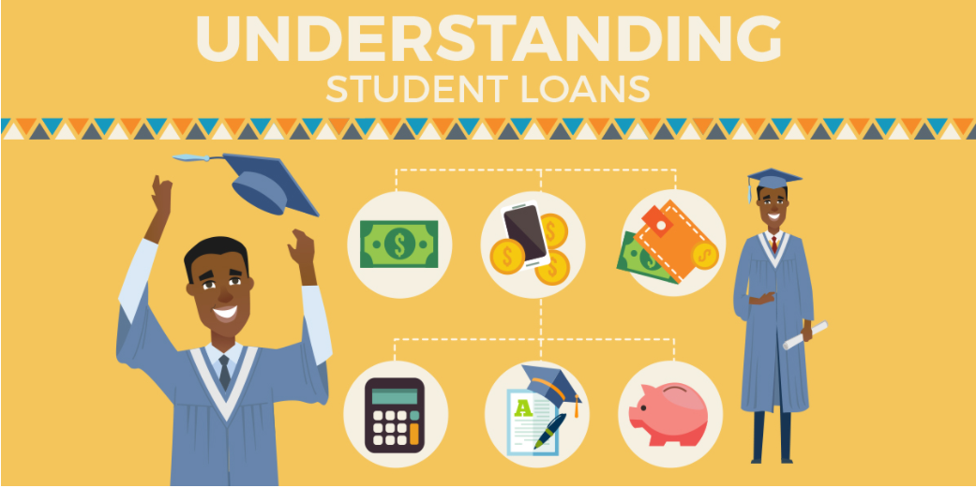
Proposal on student loans
The problem of student debt and inadequate financial knowledge grows due to students are not educated about types of loans, or even how to fund their education. Therefore, NSU should make financial literacy seminar to present this to students at the beginning of each year.
Subject: What you should know about student loans
Presenter: Subject matter faculty experts
Participator: Students are encouraged to participate
Time duration: two-three hours
Source: https://mocafi.com/

Slide 8
Proposal on student loans
Through out the financial literacy seminar, the presenter can point out some important steps that help students can make a reasonable students’ loan:
Students should consider federal student loans before taking out private loans as most of students qualify for federal student loans.
Students need to understand how much they owe overall. They should do research by themselves, including salaries, career growth, and loan repayment amounts.
They should only borrow the amount they need for educational expenses and should not borrow more than the first-year salary after graduation.
Their loan payment should be limited to ten percent of the gross monthly income. Allocating too much income toward student loans can face overburden and make it impossible to repay loans in time.

Slide 9
Proposal on student loans
The objectives of holding financial literacy seminar
By holding this seminar, students can understand how student loan work. For example, they can clearly distinguish federal student loans and private loans.
Students develop critical thinking on financial issues such as considering whether or not to take out student loans.
Students’ awareness rises about their financial decisions. For example, they will utilize loans, fill out the Free Application for Federal Student Aid, that will result in less student loan debt after graduation.
Know how to plan for the future. For example, planning for major expenditures, planning for loan payment and understand their total cost.

